Slide 1
UNIT-II Introduction to the Relational Model

Slide 2
UNIT – II
Introduction to the Relational Model: Integrity constraint over relations, enforcing integrity constraints, querying relational data, logical data base design, introduction to views, destroying/altering tables and views. Relational Algebra, Tuple relational Calculus, Domain relational calculus.
RELATIONAL MODEL
Relational data model is the most popular data model used widely around the world for data storage. In this model data is stored in the form of tables.

Slide 3
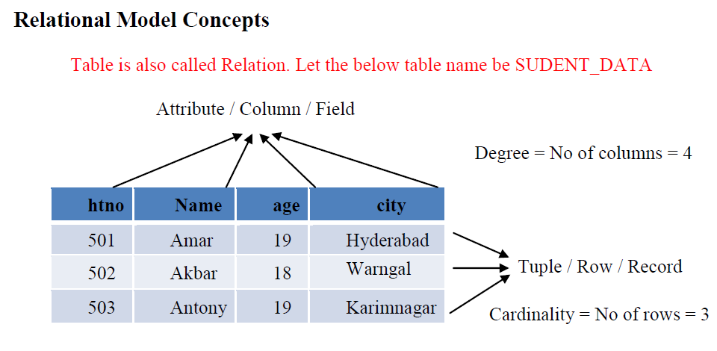

Slide 4
Table: In relational model the data is saved in the form of tables. A table has two properties rows and columns. Rows represent records and columns represent attributes.
Attribute: Each column in a Table is an attribute. Attributes are the properties that define a relation. e.g., HTNO, NAME, AGE, CITY in the above relation.
Tuple: Every single row of a table is called record or tuple.

Slide 5
A relation instance can be thought of as a table in which each tuple is a row, and all rows have the same number of fields.
Relation Schema: It represents the name of the relation (Table) with its attributes.
Eg., STUDENT_DATA( htno, name, age, city)
Degree: The total number of attributes in the relation is called the degree of the relation.
Cardinality: Total number of rows present in the Table.

Slide 6
Integrity Constraints
Data integrity is the accuracy, completeness, and reliability of data. It can be specified by the lack of variation between two instances or consecutive updates of a record, indicating that your information is error-free.
Integrity constraints are a set of rules. It is used to maintain the quality of information.
Integrity constraints ensure that the data insertion, updating, and other processes have to be performed in such a way that data integrity is not affected.
Integrity constraint is used to guard against accidental damage to the database.

Slide 7
INTEGRITY CONSTRAINT
Integrity constraints are a set of rules that the database should not violate.
Integrity constraints ensure that authorized changes (update deletion, insertion) made to the database should not affect data consistency.
Integrity constraints may apply to attribute or to relationships between tables.

Slide 8
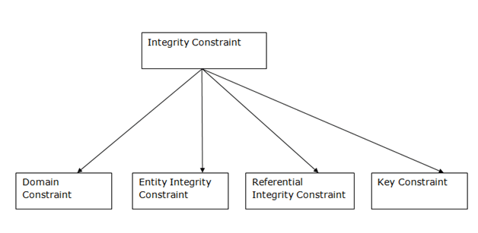
Types of Integrity Constraint

Slide 9
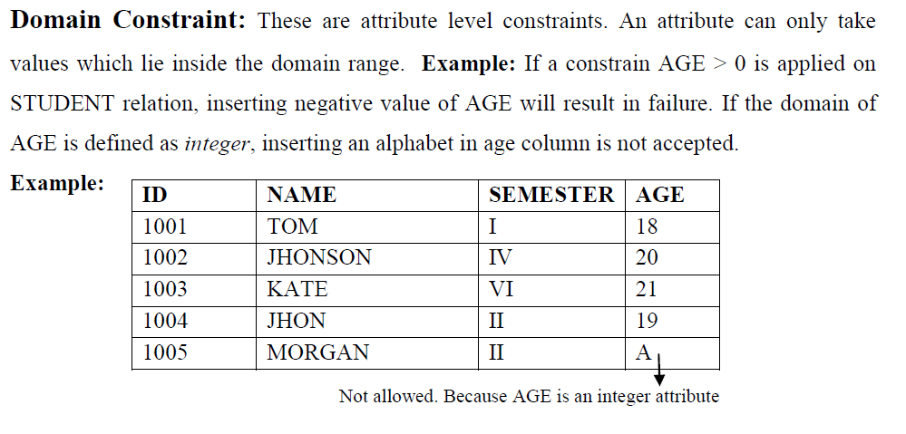

Slide 10
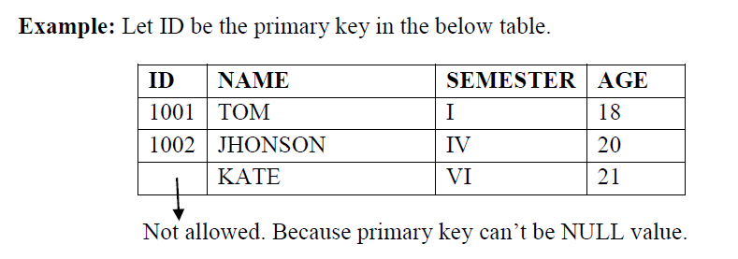
Entity integrity constraints: The entity integrity constraint states that primary key value can't be null. This is because the primary key value is used to identify individual rows in relation. A table can contain a null value other than the primary key field.

Slide 11
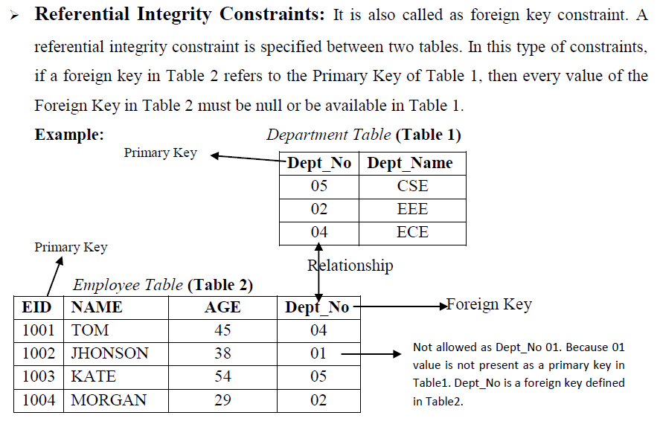

Slide 12
Key Constraints: A Key Constraint is a statement that a certain minimal subset of the fields of a relation is a unique identifier for a tuple.
There are 4 types of key constraints. They are
i. Candidate key: The candidate keys in a table are defined as the set of keys that is minimal and can uniquely identify any data row in the table.
ii. Primary key: It can uniquely identify any data row of the table. The primary key is one of the selected candidate key.

Slide 13
iii. Super key: Super Key is the superset of primary key. The super key contains a set of attributes, including the primary key, which can uniquely identify any data row in the table.
iv. Foreign key: It is a key used to link two tables together. A FOREIGN KEY is a field (or collection of fields) in one table that refers to the PRIMARY KEY in another table.
Composite Key: If any single attribute of a table is not capable of being the key i.e it cannot identify a row uniquely, then we combine two or more attributes to form a key. This is known as a composite key.
Secondary Key: Only one of the candidate keys is selected as the primary key. The rest of them are known as secondary keys.

Slide 14
ENFORCING INTEGRITY CONSTRAINTS
INTEGRITY CONSTRAINT are specified when a relation is created and enforced or imposed when a relation is modified.
7 constraint types:
1. Data type constraint: This defines the type of data, data length, and a few other attributes which are specifically associated with the type of data in a column.
2. Default constraint: This defines what value the column should use when no value has been supplied explicitly when inserting a record in the table.

Slide 15
3. Nullability constraint: This defines that if a column is NOT NULL or allow NULL values to be stored in it.
4. Primary key constraint: This is the unique identifier of the table.The primary key can be either a sequentially incremented integer number or a natural selection of data that represents what is happening in the real world. NULL values are not allowed in primary key values.
5. Foreign key constraint: This defines how referential integrity is enforced between two tables.

Slide 16
6. Unique constraint: This defines that the values in a column must be unique and no duplicates should be stored. Sometimes the data in a column must be unique even though the column does not act as Primary Key of the table.
7. Check constraint: This defines a validation rule for the data values in a column so it is a user-defined data integrity constraint. This rule is defined by the user when designing the column in a table.

Slide 17
3.4 Querying Relational Data
A relational database query is a question about the data, and the answer consists of a new relation containing the result.
A query language is a specialized language for writing queries.
SQL is the most popular commercial query language for a relational DBMS.
For example, we might want to find all students AGE less than 18 or all students enrolled in particular course.
SELECT * FROM Students WHERE age < 18;
SELECT ID,FirstName FROM Students WHERE age < 18;

Slide 18
The SELECT statement is used to fetch the data from a database table which returns this data in the form of a result table. These result tables are called result-sets.
Ex:
SELECT column1, column2, ... FROM table_name;
SELECT * FROM table_name;

Slide 19
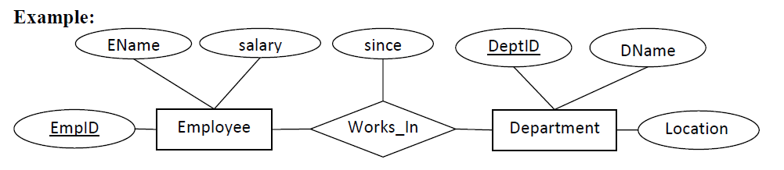
LOGICAL DATABASE DESIGN
1. Each entity in the ER model will become a table and all attributes of that entity will become columns of the table. Key attribute of the entity will become primary key in the table.

Slide 20
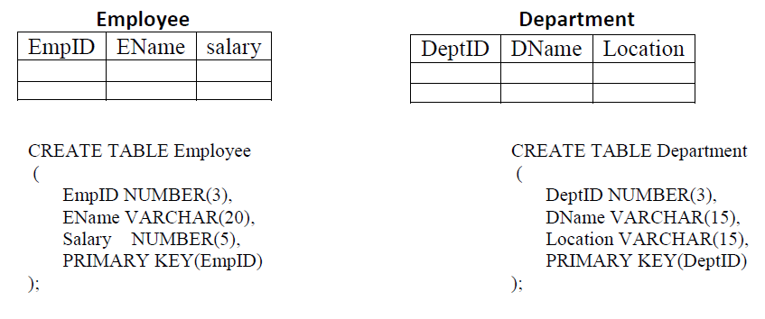

Slide 21
2. Each relationship in the ER model will become a table. Key attributes of participating entities in the relationship will become columns of the table. If the relationship has any attributes, then they also will become columns of the table.
Example: From the above ER diagram, the Works_In relationship converted as

Slide 22
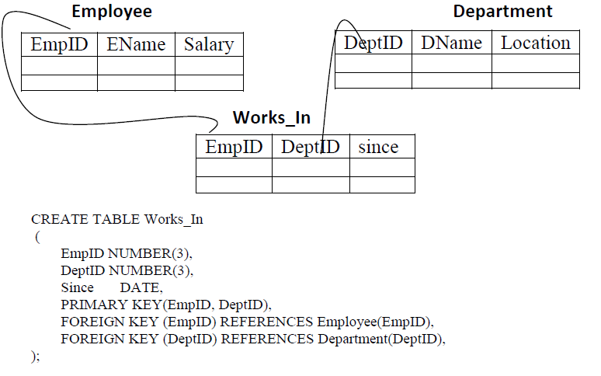

Slide 23
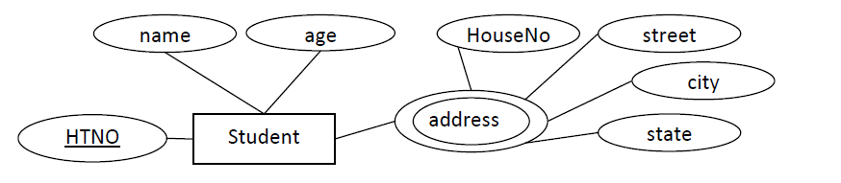
3. Any multi-valued attribute is converted into new table. The primary key of the entity will be added as column in the new table.

Slide 24
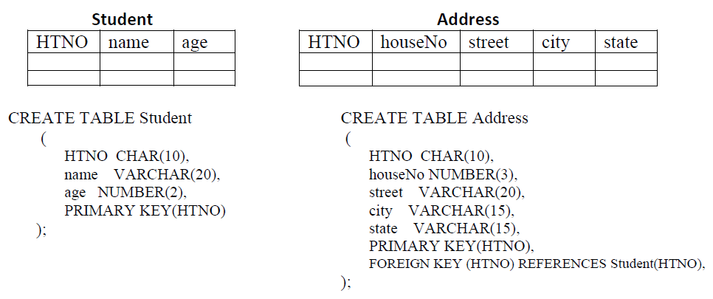

Slide 25
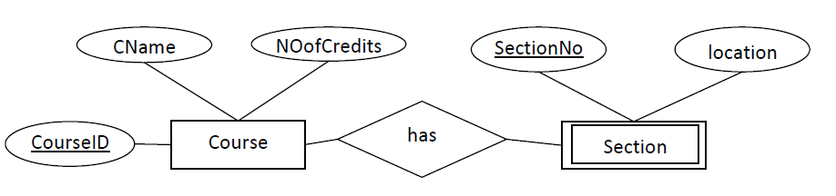
4. Each weak entity is converted into a table with all its attributes as columns and primary key of the strong entity acts as a foreign key in this table.

Slide 26
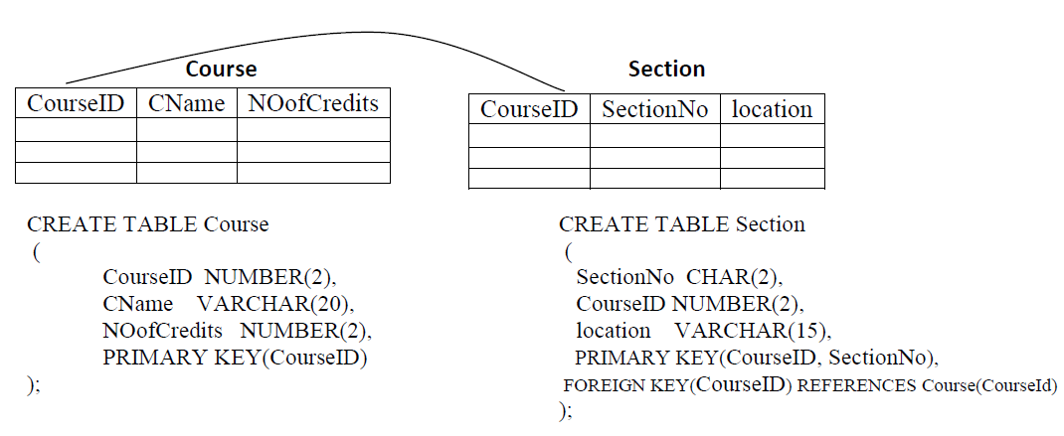

Slide 27
INTRODUCTION TO VIEWS
A view is virtual tables whose rows are not explicitly stored in the database .
They are used to restrict access to the database or to hide data complexity.
A view contains rows and columns, just like a real table.
Creating a view does not take any storage space as only the view query is stored in the data dictionary and the actual data is not stored.
The tables referred in the views are known as Base tables.
Views do not contain data of their own.
They take data from the base tables.

Slide 28
The reasons for using views are
Security is increased - sensitive information can be excluded from a view.
Views can represent a subset of the data contained in a table.
Views can join and simplify multiple tables into a single virtual table.
Views take very little space to store; the database contains only the definition of a view, not a copy of all the data it presents.
Different views can be created on the same base table for different categories of users.

Slide 29
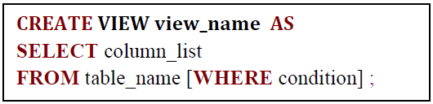
Creating Views syntax:

Slide 30
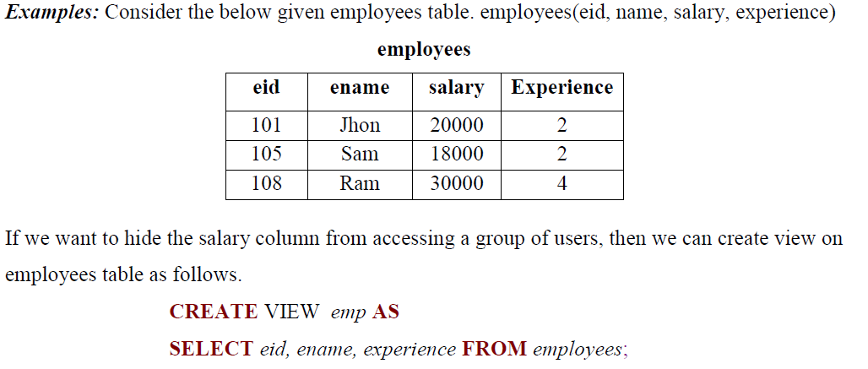

Slide 31
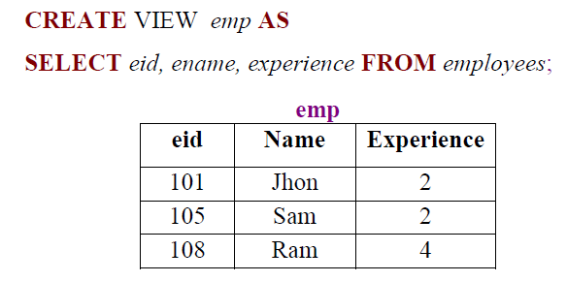

Slide 32
When can insertion, delete or update performed on view?
The view is defined from one and only one table.
The view must include the PRIMARY KEY of the base table.
The base table columns which are not part of view should not have NOT NULL constraint.
The view should not have any field made out of aggregate functions.
The view must not have any DISTINCT clause in its definition.
The view must not have any GROUP BY or HAVING clause in its definition.
The view must not have any SUBQUERIES in its definitions.

Slide 33
Inserting Rows into a View: A new row can be inserted into a view in a similar way as you insert them in a table. When an insert operation performed on view, first a new row is inserted into the base table and the same is reflected in the view.
INSERT INTO CustomerActiveView (CustomerID, CustomerName, PhoneNumber) VALUES (123, 'John Doe', '555-1234');

Slide 34
Step 1: Create the Table
First, let's create a simple table. We’ll create a table called products.
CREATE TABLE products (
product_id INT PRIMARY KEY,
product_name VARCHAR(100),
price DECIMAL(10, 2)
);

Slide 35
Step 2: Insert Some Data into the Table
Next, let’s insert some data into the products table.
INSERT INTO products (product_id, product_name, price)
VALUES
(1, 'Laptop', 899.99),
(2, 'Smartphone', 499.99),
(3, 'Headphones', 89.99);

Slide 36
Step 3: Create a Simple View
Now, let's create a simple view that selects all columns from the products table.
Since the view only selects from one table and
does not involve any complex operations, it will be updatable.
CREATE VIEW product_view AS
SELECT product_id, product_name, price
FROM products;

Slide 37
Step 4: Insert Data via the View
Since the view is updatable, we can insert new data into the products table
using the product_view view.
INSERT INTO product_view (product_id, product_name, price)
VALUES (4, 'Keyboard', 29.99);

Slide 38
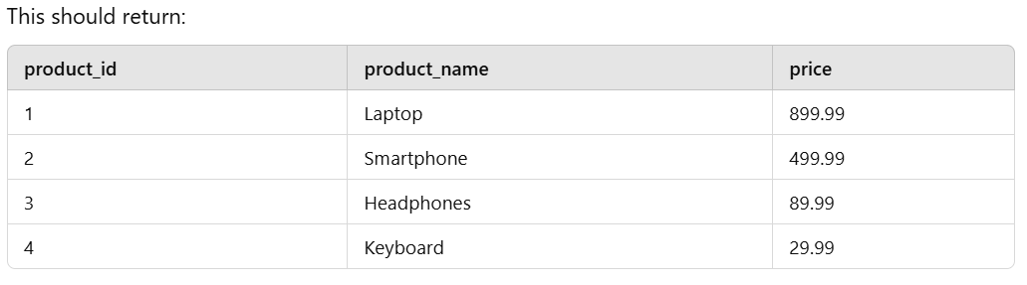
Step 5: Verify the Insert
Now, let’s verify that the new product has been inserted into the products table
by selecting from the products table directly:
SELECT * FROM products;

Slide 39
Here’s an example of how to insert data into a table using a view:
Step 1: Create the Base Tables
Let's assume we have two tables: employees and departments.
Create Employees Table
CREATE TABLE employees (
emp_id INT PRIMARY KEY,
emp_name VARCHAR(100),
department_id INT
);
Create Departments Table
CREATE TABLE departments (
dept_id INT PRIMARY KEY,
dept_name VARCHAR(100)
);

Slide 40
Step 2: Create a View
Now, let's create a view that combines information from both the
employees and departments tables.
CREATE VIEW employee_details AS
SELECT e.emp_id, e.emp_name, d.dept_name
FROM employees e
JOIN departments d ON e.department_id = d.dept_id;
This view (employee_details) will show the employee’s ID, name, and
department name, combining the information from the employees and
departments tables.

Slide 41
Step 3: Insert Data into the Base Table
Now, let's insert some data into the employees and departments tables:
Insert data into departments table
INSERT INTO departments (dept_id, dept_name) VALUES (1, 'HR'), (2, 'Finance'), (3, 'IT');
Insert data into employees table
INSERT INTO employees (emp_id, emp_name, department_id) VALUES
(101, 'John Doe', 1),
(102, 'Jane Smith', 2),
(103, 'Alice Brown', 3);

Slide 42
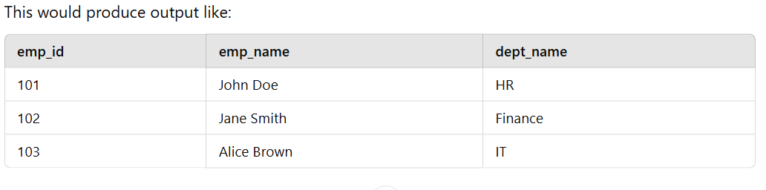
Step 4: Query the View
You can now select from the view to see the combined data:
SELECT * FROM employee_details;

Slide 43
You cannot directly insert data into a view
if the view is complex (e.g., joins multiple tables),
since it doesn’t hold data itself. It’s just a virtual representation.
However, updatable views allow inserts
if the view is simple enough (like a single table or with specific rules in place).
If the view contains any aggregate functions
(e.g., SUM(), AVG()) or joins, you won’t be able to insert data
via the view.

Slide 44
Deleting Rows into a View:
A row(s) can be deleted from a view in a similar way as you delete them from a table. When an delete operation performed on view, first row(s) is/are deleted from the base table and the same is reflected in the view.
Updating Rows into a View:
A row(s) can be updated in a view in a similar way as you update them in a table. When an update operation performed on view, first data is updated in the base table and the same is reflected in the view.

Slide 45
Dropping/Destroying View:
Whenever you do not need the view anymore, we can destroy the view by using DROP command. The syntax is very simple and is given below
DROP VIEW view_name;
Example: DROP VIEW emp;

Slide 46
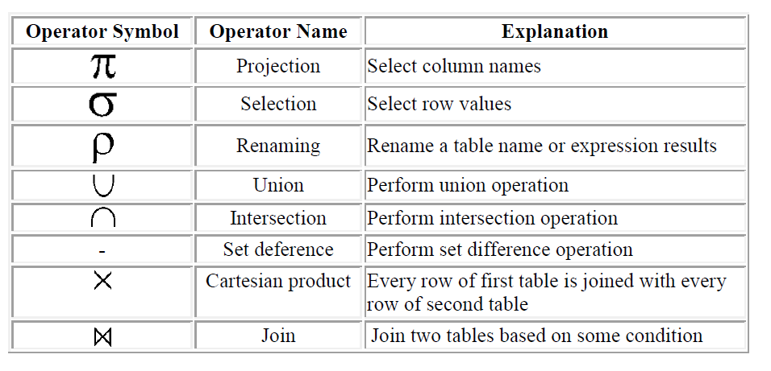
RELATIONAL ALGEBRA
Relational Algebra is procedural query language, which takes Relation as input and generates relation as output. Relational algebra mainly provides theoretical foundation for relational databases and SQL.

Slide 47
Select Operation (σ): It selects tuples that satisfy the given predicate from a relation.
Notation : σp(r)
where σ stands for selecting tuples (rows) and r stands for relation (table) name.
p is prepositional logic formula which may use connectors like and, or, and not.
These terms may use relational operators like = , ≠ , ≥ , < , > , ≤ .
Example 1: σsubject = "database"(Books)
Output : Selects rows whose subject is 'database' from books table.
Example 2: σ subject = "database" and price = "450"(Books)
Output : Selects rows from books where subject is 'database' and 'price' is 450.

Slide 48
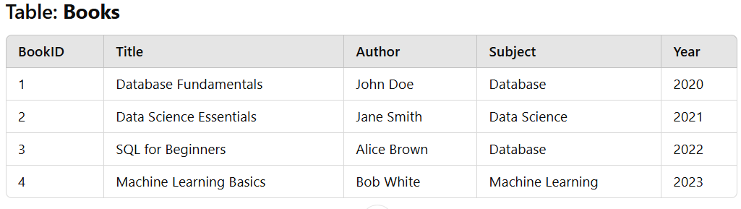
Example 1: σsubject = "database"(Books)
Output : Selects rows whose subject is 'database' from books table.

Slide 49
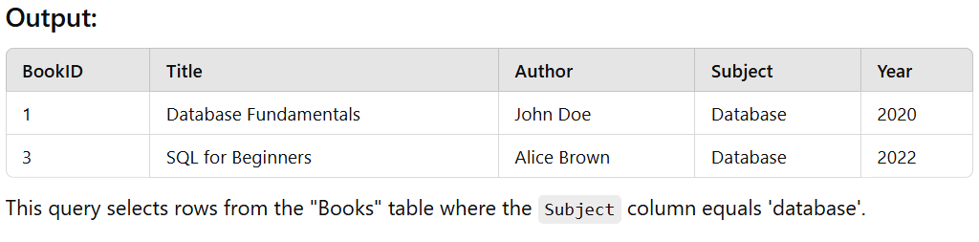
SQL Query:
SELECT * FROM Books WHERE Subject = 'database';

Slide 50
Project Operation (Π): It projects column(s) that satisfy a given predicate.
Notation: ΠA1, A2, … An (r)
where A1, A2 , An are column (attribute) names of relation r. Duplicate rows are automatically eliminated in the output.
Example: Πsubject, author (Books)
Display values from columns subject and author from the relation Books.

Slide 51
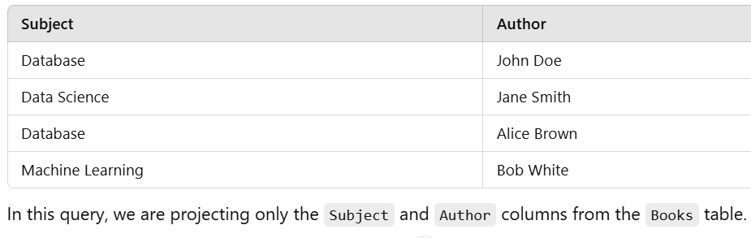
Example: Πsubject, author (Books)
SQL Query: SELECT Subject, Author FROM Books;

Slide 52
Union Operation (∪): It performs union operation between two given relations. It combines rows from two given relations.
Notation: r U s
Where r and s are database relations .
r U s returns a relation containing all tuples that occur in either relation r or relation s (or both).
For a union operation to be valid, the following conditions must hold:
r and s must have the same number of attributes.
Attribute domains must be compatible in r and s.

Slide 53
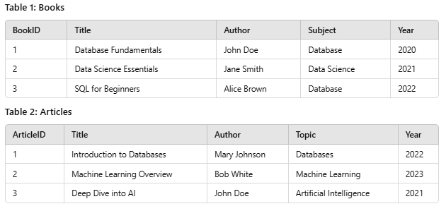
Example: Π author(Books) ∪ Π author(Articles)
SQL Query: SELECT Author FROM Books UNION SELECT Author FROM Articles;

Slide 54
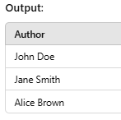
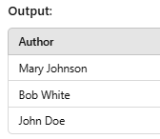
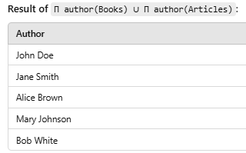

Slide 55
Intersection Operation (∩): It performs intersection operation between two given relations . It collect only rows which are common in the two given relations.
Notation: R ∩ S
R ∩ S returns a relation containing all tuples that occur in both R and S.
The relations R and S must be union-compatible, and the schema of the result is defined to be identical to the schema of R.
Example: Π author(Books) ∩ Π author(Articles)
Output: Projects the names of the authors who have written both book and an article.

Slide 56
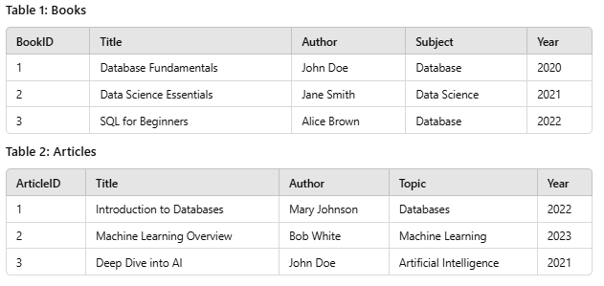
Example: Π author(Books) ∩ Π author(Articles)
Output: Projects the names of the authors who have written both book and an article

Slide 57
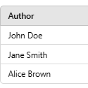
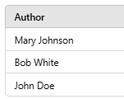

Example: Π author(Books) ∩ Π author(Articles)
Output: Projects the names of the authors who have written both book and an article
Π author (Books):
Π author (Articles):

Slide 58
Set Difference (−): It finds tuples which are present in one relation but not in the second relation.
Notation: r − s
Finds all the tuples that arepresent in r but not in s
Example: Π author (Books) − Π author (Articles)
Output: Provides the name of authors who have written books but not articles.

Slide 59
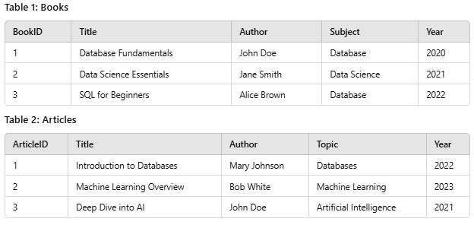
Example: Π author (Books) − Π author (Articles)

Slide 60
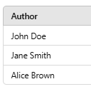
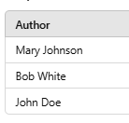
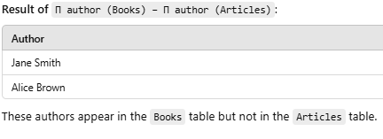
Π author (Books):
Π author (Articles):

Slide 61
Rename Operation (ρ):
The results of relational algebra are also relations but without any name.
The rename operation allows us to rename the output relation.
'rename' operation is denoted with small Greek letter rho ρ.
Notation: ρ( temp, E)
Where the result of expression E is saved with name of temp.

Slide 62
Cartesian Product (Χ): It returns a relation whose schema contains all the fields of table-1 (in the same order as they appear in table-1) followed by all the fields of table-2.
It combines every row in first table with every row in the second table.
Notation: r Χ s
Where r and s are relations and their output will be definedas : r Χ s = { q t | q ∈ r and t ∈ s}

Slide 63
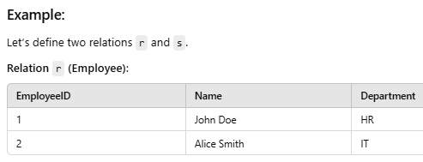
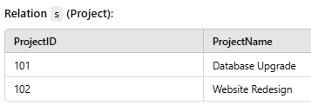
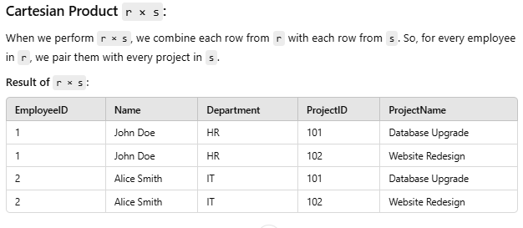

Slide 64
Division (/):
Consider two relation A and B in which A has (exactly) two fields x and y and B has just one field y, with the same domain as in A.
We define the division operation A / B as the set of all x values (in the form of unary tuples) such that for every y value in (a tuple of) B, there is a tuple (x,y) in A.
A ⊆ B

Slide 65
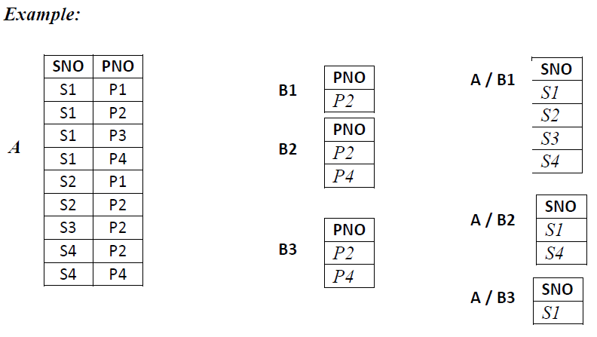

Slide 66




The join condition is identical to a selection condition in form. The operation is defined as follows:
Thus is defined to be a cross-product followed by a selection.
Note that the condition c can refer to attributes of both Rand S.

Slide 67
RELATIONAL CALCULUS
Relational calculus is an alternative to relational algebra.
In contrast to the algebra, which is procedural, the calculus is nonprocedural, or declarative.
It allows us to describe the set of answers without being explicit about how they should be computed.
1. Tuple Relational Calculus
2. Domain Relational Calculus
Quantifiers
∃ (Existential Quantifier) → There exists at least one value satisfying the condition.
∀ (Universal Quantifier) → All values must satisfy the condition.

Slide 68
1 Tuple Relational Calculus
Tuple Relational Calculus is a non-procedural query language unlike relational algebra.
Tuple Calculus provides only the description of the query but it does not provide the methods to solve it.
Thus, it explains what to do but not how to do.
In Tuple Relational Calculus,
a query is expressed as {t| P(t)}

Slide 69
In Tuple Relational Calculus,
a query is expressed as {t| P(t)}
Where,
t = resulting tuples,
P(t) = known as Predicate and
these are the conditions that are used to fetch t.
Thus, it generates set of all tuples t,
such that Predicate P(t) is true for t.

Slide 70
P(t) may have various conditions logically combined with . OR (∨), AND (∧), NOT(¬).
It also uses quantifiers:
∃ t ∈ r (Q(t))
”there exists” a tuple in t in relation r such that predicate Q(t) is true.
∀ t ∈ r (Q(t))
Q(t) is true “for all” tuples in relation r.

Slide 71
Tuple Relational Calculus (TRC)
Example - Student Database Schema:
Let's assume we have a Student relation with the following attributes:
Student(ID, Name, Age, Major, GPA)
Example 1:
Find all students majoring in 'Computer Science‘
Example 2:
Find names of students with GPA greater than 3.5
Example 3:
Find students older than 21 and studying 'Mathematics'

Slide 72


This expression returns all tuples S from the Student relation where the Major attribute is 'Computer Science'.

Slide 73
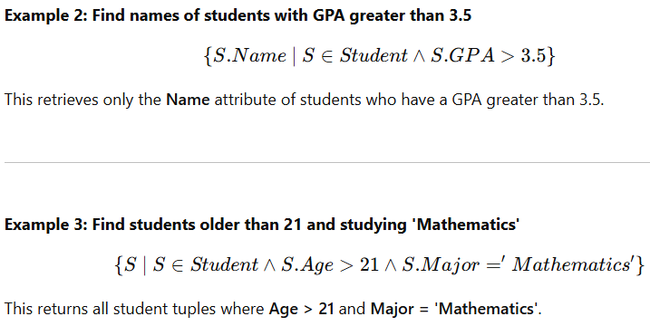

Slide 74
2. Domain Relational Calculus
A domain variable is a variable that ranges over the values in the domain of some attribute
A DRC query has the form
{ 〈 x1, x2, . . . , xn 〉 | p(〈x1,x2,.. ., xn〉)}
where
each xi is either a domain variable or field
p(〈x1,x2,.. ., xn〉) denotes a DRC formula

Slide 75
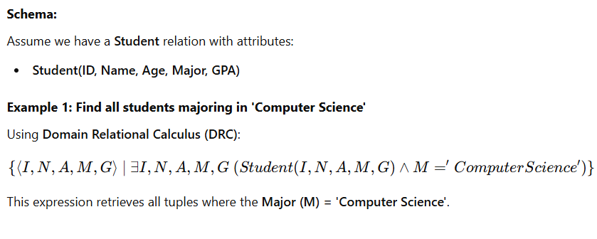

Slide 76
